Slide 1
Superstore Sales Dashboard
An Interactive Power BI Dashboard for Business Stakeholders

Slide 2
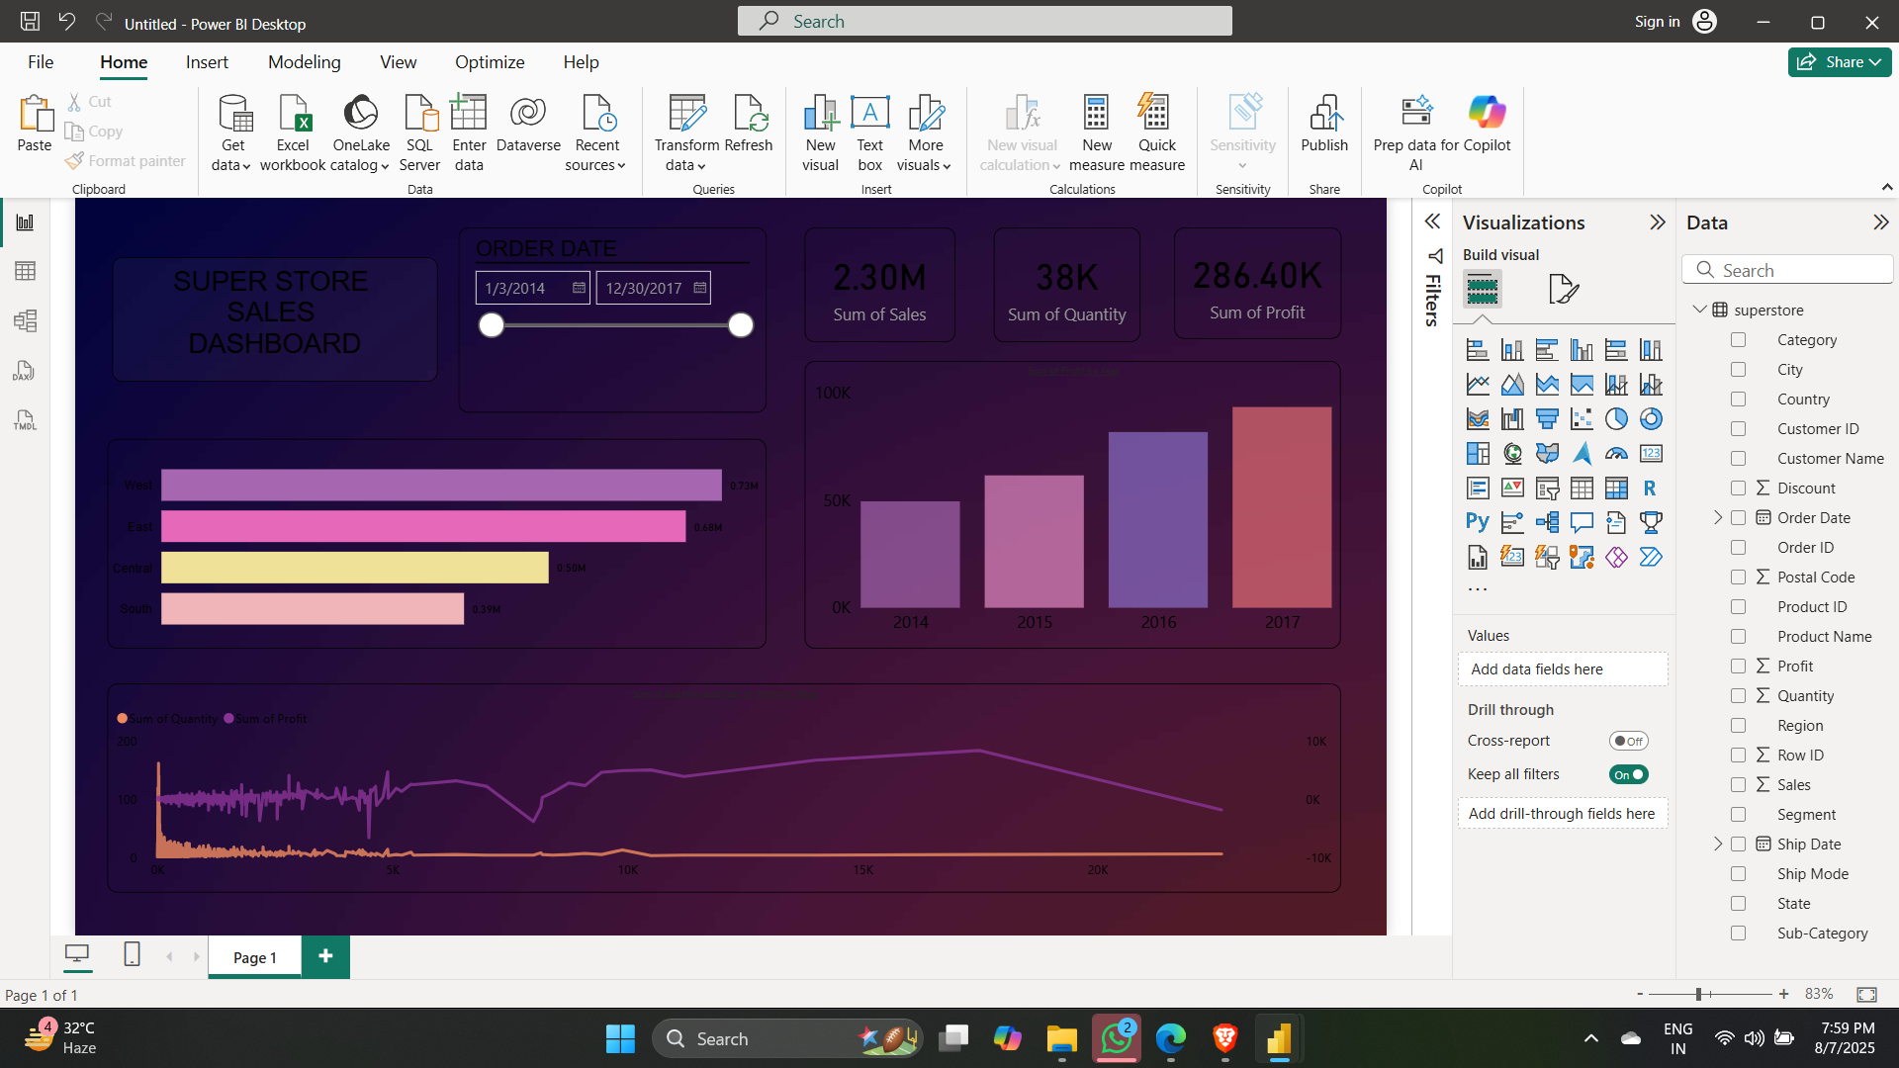

Slide 3
Key KPIs and Design Highlights
✅ Selected KPIs:
Total Sales
Total Profit
Quantity Sold
Yearly Sales
Regional Performance
🎨 Design:
Dark Theme
KPI Cards
Slicers for Date
Interactive visuals

Slide 4
Dashboard Interactivity & Features
Slicers (Date Range)
Bar Chart (Sales by Region)
Cards for Sales, Profit, Quantity
Column Chart (Year-wise Sales)
Line Chart (Profit & Quantity Trends)

Slide 5
Interview Questions
Q: What are the key elements of a dashboard? A: KPIs, visuals, filters, layout, interactivity, design consistency.
Q: What is a KPI? A: A measurable metric showing performance (e.g. Profit Margin).
Q: What are slicers in Power BI? A: Visual tools to filter dashboard content by fields like Date, Region.
Q: Difference between Power BI and Tableau? A: Power BI: Microsoft tool, cheaper. Tableau: powerful visuals.
Q: How to make dashboards interactive? A: Use slicers, drill-throughs, bookmarks, and tooltips.
Q: How to handle large datasets? A: Use aggregation, filters, model optimization, and paginated reports.
Q: Charts for trend analysis? A: Line charts, area charts, combo charts (bar+line)

Slide 6
Superstore Sales Dashboard Summary
📌 Overview:
Dashboard built using Power BI with interactive elements.
Tracks Sales, Profit, and Quantity over time and across regions.
📊 Key Metrics (Cards at Top):
Total Sales: 2.30M
Total Quantity: 38K
Total Profit: 286.40K
📅 Time Frame:
Order Date slicer from Jan 2014 to Dec 2017
📈 Visualizations Used:
Bar Chart: Sales by Region (West, East, Central, South)
Column Chart: Year-wise Sales (2014–2017)
Line Chart: Quantity & Profit Trends over time

Slide 7
🎨 Design Highlights:
Dark theme with vibrant bar/line colors
Clean layout with sections for KPIs, trends, and filters
Slicers enable dynamic interactivity
📥 Insights:
West region leads in total sales
2017 had the highest recorded yearly sales
Noticeable seasonal patterns in sales trends

